Slide 1
Sleep deprivation
A major public health concern
Humayun Kabir, MBBS, DTCD, MD, FCCP, FACP, FAASM
CEO, Appalachian Sleep Disorders Center, USA
Director, Intensive Care Unit, North Knoxville Hospital
Tennessee, USA

Slide 2
objective
Introduce the concept
Adverse health effect
Impact in the society
Public health concerns
Recommendation

Slide 3
Sleep Disorders
Insomnia
Hypersomnia
Parasomnia

Slide 4
Sleep deprivation
(Not Enough Sleep)

Slide 5
Sleep deprivation
Physical Health problems
Behavioral problems
Mental Health consequences
Societal impact

Slide 6

Sleep & life
Every living creature
sleeps!

Slide 7
Is sleep essential for survival?
Notes:
১১ দিনের মাথায় ইদুরগুলো মরতে শুরু করে, ৩২ দিনে সব মারা যায়

Slide 8
Yes, Sleep is essential for Survival!
Continuous sleeplessness leads to DEATH
Continuous sleep restriction leads to Early Death
Notes:
শিকাগো। ইদুরগুলো মরলো ১১-৩২ দিনে। /// নিদ্রা স্বল্পতা । বৃটিশ/ইটালি। ১.৩ মিলিয়ন, ২৫ বছর, ইউরোপ, আমেরিকা, এশিয়া। ১২% অকাল মৃত্যু

Slide 9
And
Sleep is essential for health
Physical well-being
Mental well-being
Social well-being

Slide 10
Process of Sleep
Process A (Sleep Pressure): As we consume energy, adenosine builds up; longer we stay awake, sleep pressure increases linearly
Process B (Circadian Rhythm): Darkness gives signal to retina, from there signal goes to hypothalamus and then to pineal gland. Pineal gland starts secreting Melatonin, body temp falls and we start sleeping

Slide 11
Sleep stages
(90 minutes cycle)
Non-REM sleep
REM Sleep
(REM: Rapid eye movement)

Slide 12
Non-rem sleep
Stage 1
Stage II
Stage III and IV or Delta Sleep

Slide 13
Function of sleep
Memory consolidation, Attention and Learning
Regulation of metabolic functions through hormonal manipulation
Facilitation of Immune function
Waste removal from brain

Slide 14
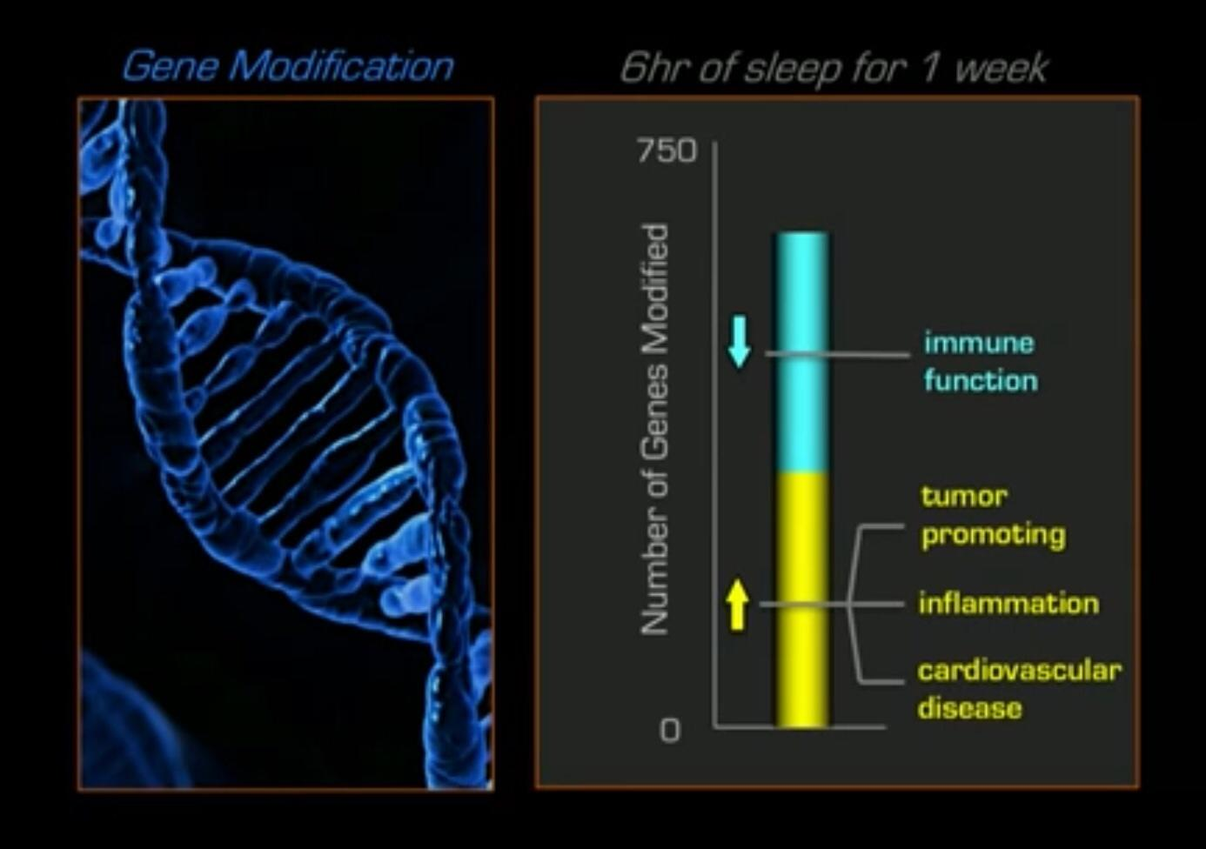
Lack of Sleep and immunity

Slide 15
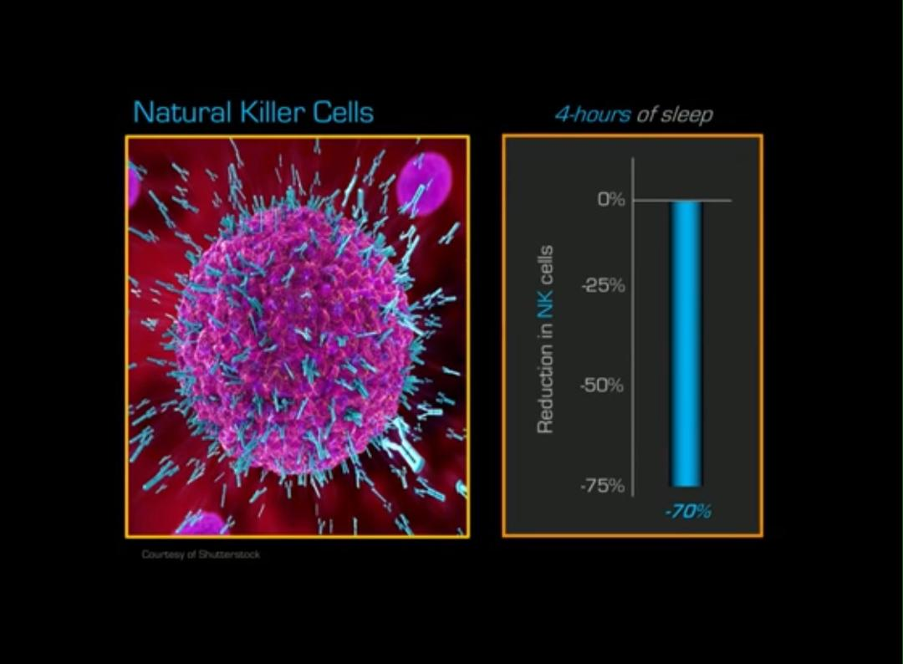

Slide 16
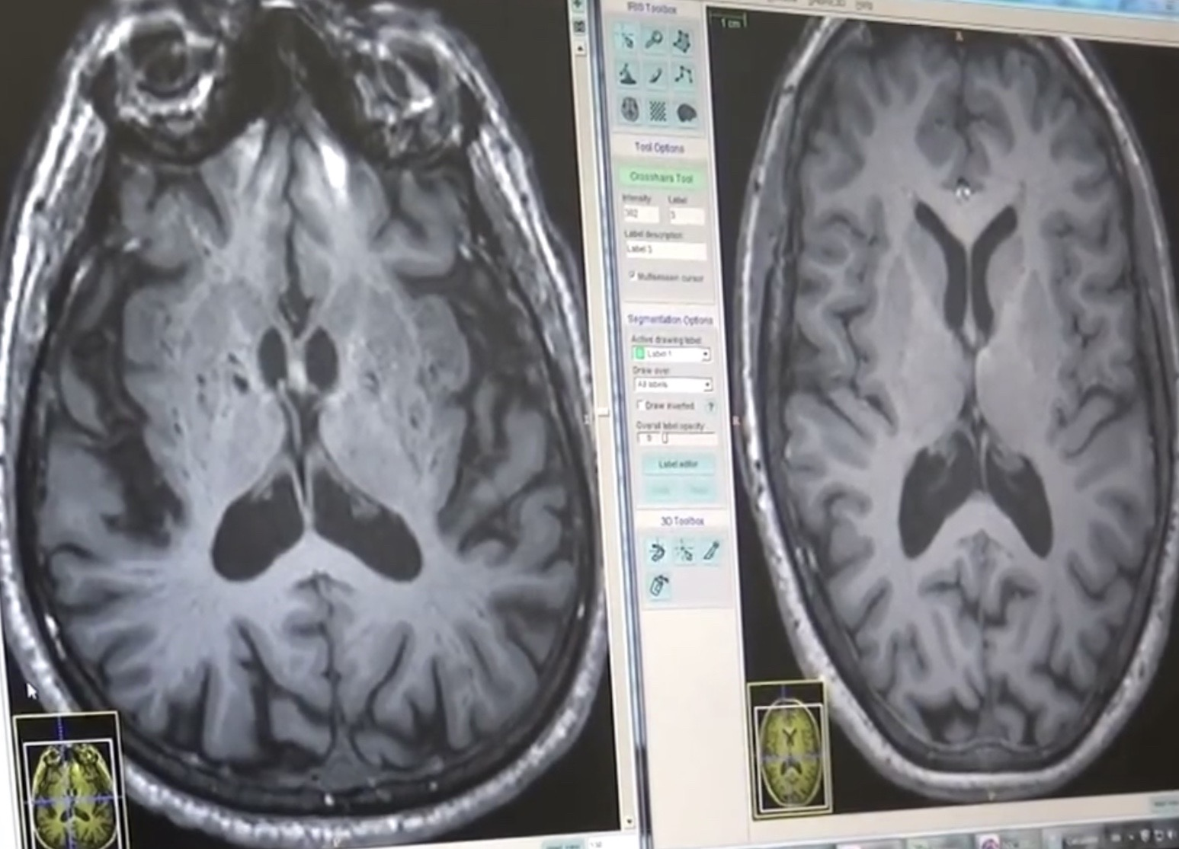
Waste removal from brain

Slide 17
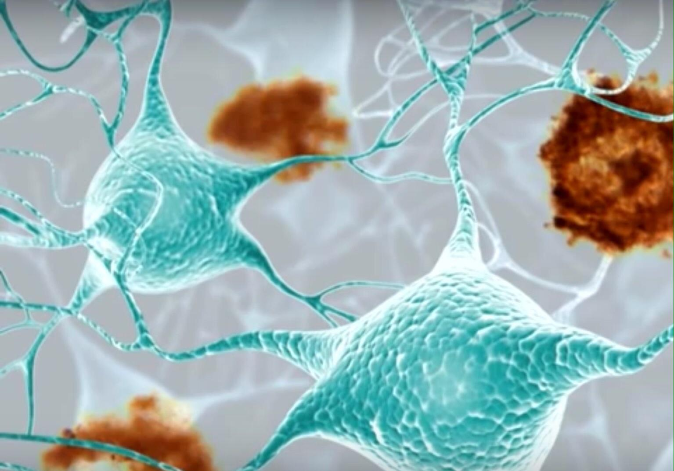
Amyloid beta: Dementia

Slide 18
Sleep and hormone
Growth Hormone: Highest in delta sleep
Cortisol: Highest in morning
Prolactin: Highest in delta sleep
Thyroid Stimulating Hormone: Lowest in daytime
Testosterone: Highest before REM sleep
Leptin: Mid-night to 4 am
Oxytocin: REM and Non-REM dream

Slide 19
Effect of Sleep Deprivation
Psychiatric Disorders
Poor attention and faulty decision making
Obesity
Hypertension
Coronary Disease
Stroke
Dementia
Erectile Dysfunction
Cognitive Dysfunction
Reduced Immunity
Increased Cancer

Slide 20
We have a problem in USA
Psychiatric illnesses are rising (1 in 5)
Crimes and drugs are rising
(drug related death 100,000/Year)
(2.12 million people were incarcerated in 2020 for different crimes)
Gun violence is rising
Social disharmony is rising

Slide 21
Sleep need
Adults: 8 hours, Teenager: 9-10 hours
35% of U.S adults are sleep deprived
87% of U.S teenagers are sleep deprived

Slide 22
Alarming teenage trend
School grades are going downwards
Childhood Obesity, HTN, Diabetes rising alarmingly
Delinquency, mental illness, suicide rate rising
Auto accidents rising

Slide 23
red flag
Per capita spending on high school education in US: $15,908.00, highest in the world
Overall rating of US education system is #1 in the world (US News/U Pen)
BUT
US kids ranked 38th in math, 24th in science (2018 data, Business insider)
Smartest students list: US ranked 13th (Forbes, 2019)

Slide 24
Sleep deprivation
American pediatric association has declared seep deprivation a major public health crisis.
American academy of pediatrics proposed to delay school start time nationwide
American academy of sleep medicine issued consensus statements

Slide 25

sleep Chronobiology
Sleep is a cyclical and rhythmic event closely related to the circle of universe

Slide 26
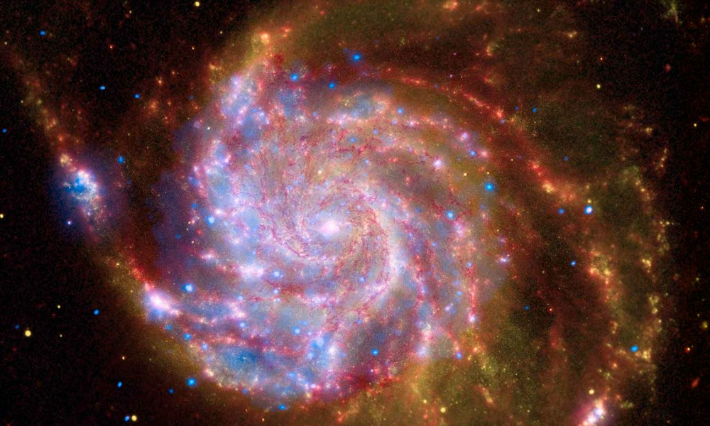
Universe is moving with its mass
Notes:
১৩ বিলিয়ন বছর। ১০-৫৩ কিলো । ডার্ক মেটার।

Slide 27

Circle in atom
Notes:
প্রোটন, নিউট্রন, ইলেকট্রন। কোয়ার্ক, লেপটন, বোসন।

Slide 28
body Cycle
Infradian Rhythm
Circadian Rhythm
Ultradian Rhythm
Notes:
Ultradian; Feeding cycle. Infradian: Menstrual cycle

Slide 29
Body clock
Master Clock: Brain (Hypothalamus)
Minor Clock: All organs

Slide 30
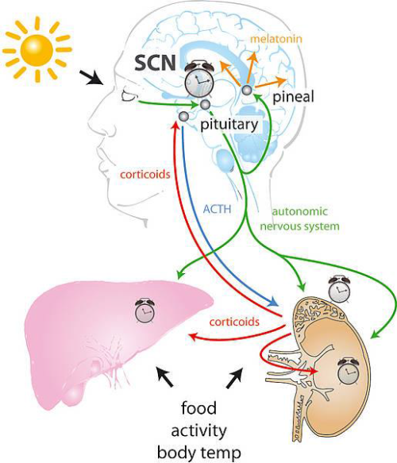
Master clock minor clock
Symphony
of body, mind and spirit

Slide 31
Control of master clock
Light (Primary determinant)
Food
Other factors

Slide 32
Blue light in a 24-hr society
We are going to bed late
We are using blue light emitting devices at late night
This is causing sleep phase delay.

Slide 33
In the morning, science and math classed are attended by sleep deprived students with sleep phase delay (chronobiologically still in sleep time!)

Slide 34
Impaired reaction time and micro-sleep is responsible for majority of the fatal auto accidents
All top ten major accidental disasters in human history were linked to sleep deprivation

Slide 35
Sleep deprivation is a
major public health concern indeed!

Slide 36
Short list of recommendations
Follow sleep hygiene
Allow enough time in bed for optimum sleep
Avoid blue light

Slide 37
Thank you!

